Slide 1

Building a model to predict whether or not a person will likely pay back a loan.
By Natalia Katchoura

Slide 2
The Problem
The major problem for any financial companies is to estimate the risks associated with money loans, both for the borrower and the lender.

Slide 3
The Solution
To built models to predict whether or not a person will likely pay back a loan

Slide 4
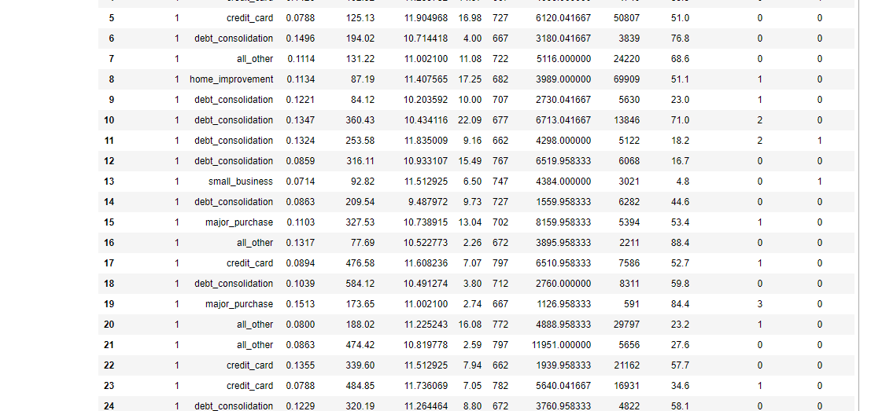
The Data
LendingClub historical data of approved loans 2007 to 2018 that can be obtained on Kaggle.

Slide 5
Data Wrangling
dropped all the columns where missing values exceeded 80%
dropped columns with identical values ( >95% of records have the same value)
select only records where loan status equal 'Fully Paid' or 'Charged off’ (2,260,699 reduced to 1,345,310 records)
keep only one of highly correlated features
drop all categorical features with many levels
dropped all irrelevant or unknown by the time of the loan features
I examined 2.27M approved loans to analyze which of 151 characteristics affect the most the loans approval, the loan rates, terms and conditions, loan classification by grade.

Slide 6
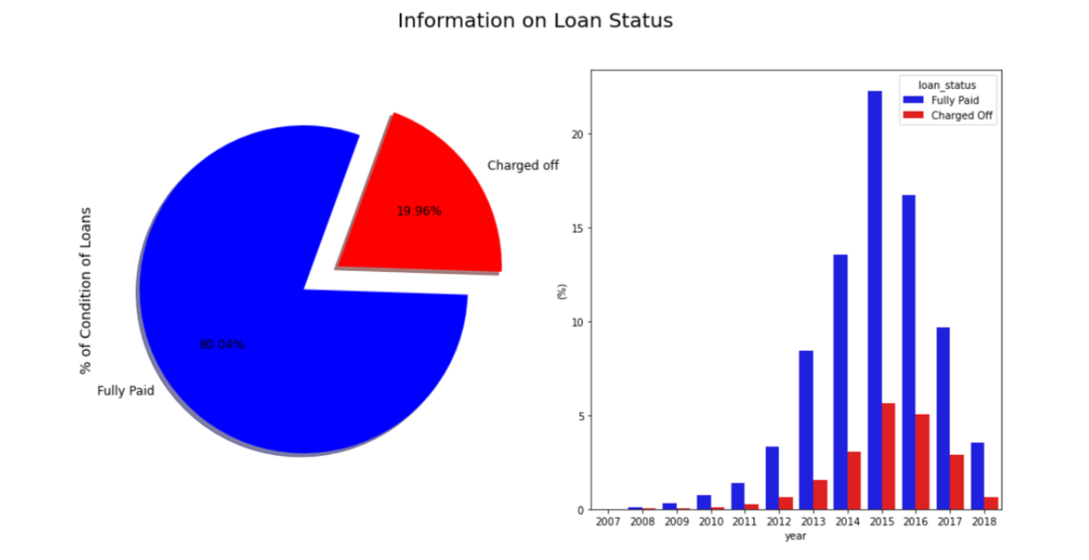
Exploratory Data Analysis

Slide 7
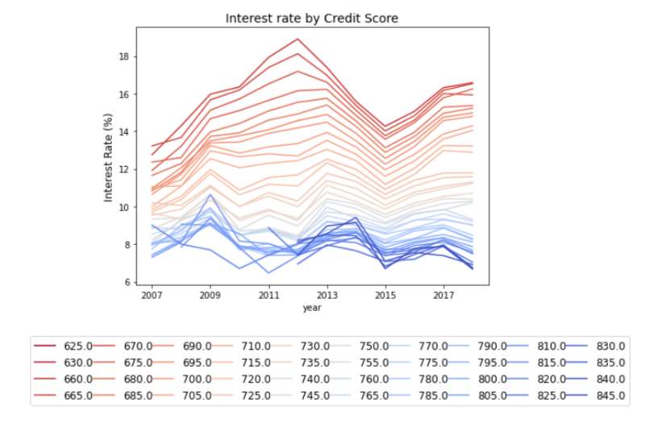
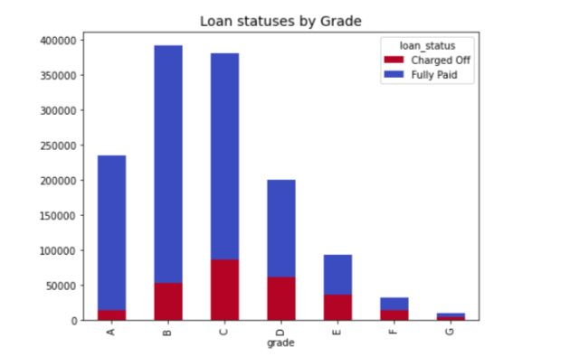
Exploratory Data Analysis(cont.)

Slide 8
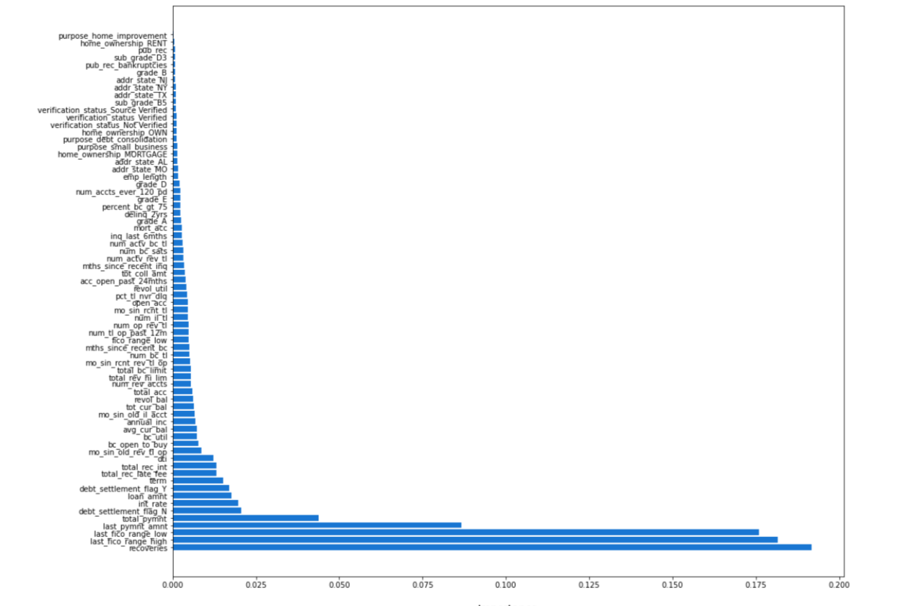
Recursive feature selection
Optimal features;
debt_settlement_flag_N
debt_settlement_flag_Y
total_pymnt
last_pymnt_amnt
recoveries
revol_util
total_rec_int
total_rec_late_fee

Slide 9
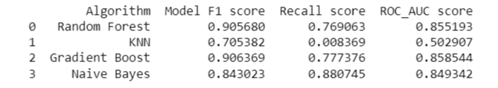
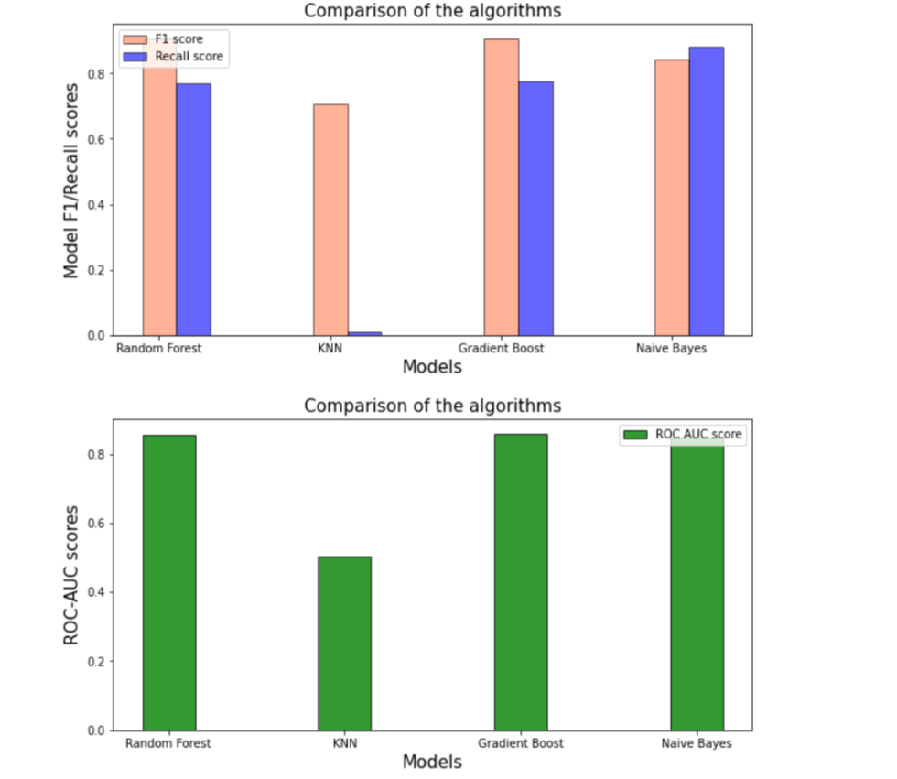
Comparison of the Algorithms
The two best performing models are the Random Forest and the Gradient boost.

Slide 10
Future Research
create a model to predict if a person is qualified for a loan and determine loan classification grade
expand these models to include the data of applicants who were rejected by Lending Club.

Slide 11
Thank you
Natalia Katchoura
Email: natakatch@gmail.com
Final report :
https://github.com/natakatch/Springboard/blob/main/Capstone%20two/reports/Capstone%20Two_%20Lending%20Club%20Final%20Report.pdf

